Slide 1
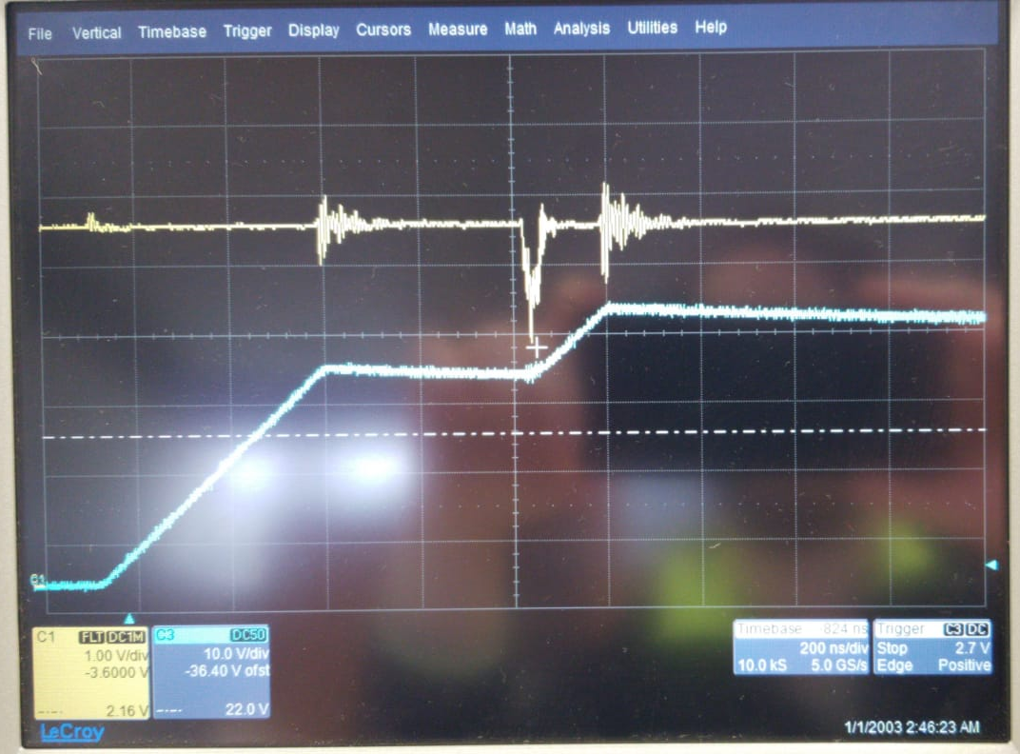
Noise
There is a drop on 5V
Lets change the isolated converters
@300V
Yellow 5V
Blue LoadCurrent

Slide 2
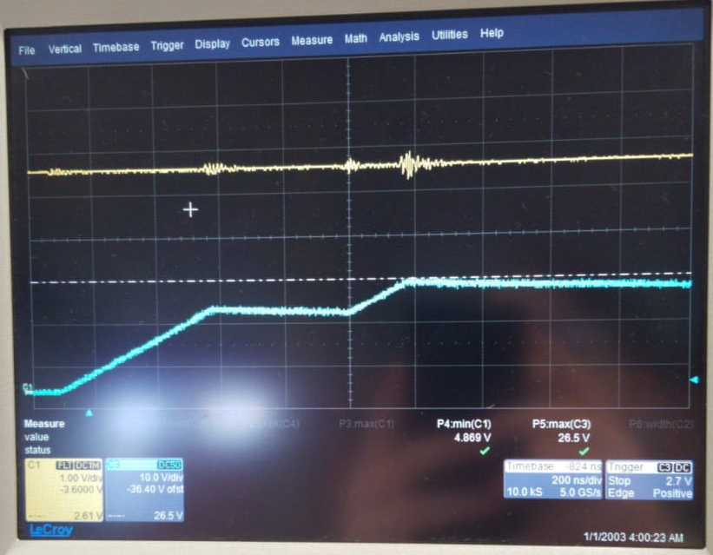
Noise
Hmm, 5V does not drop but SC is triggered.
Lets connect a capacitor (2.2nF) between SGND and PGND
@220V
Yellow 5V
Blue LoadCurrent

Slide 3
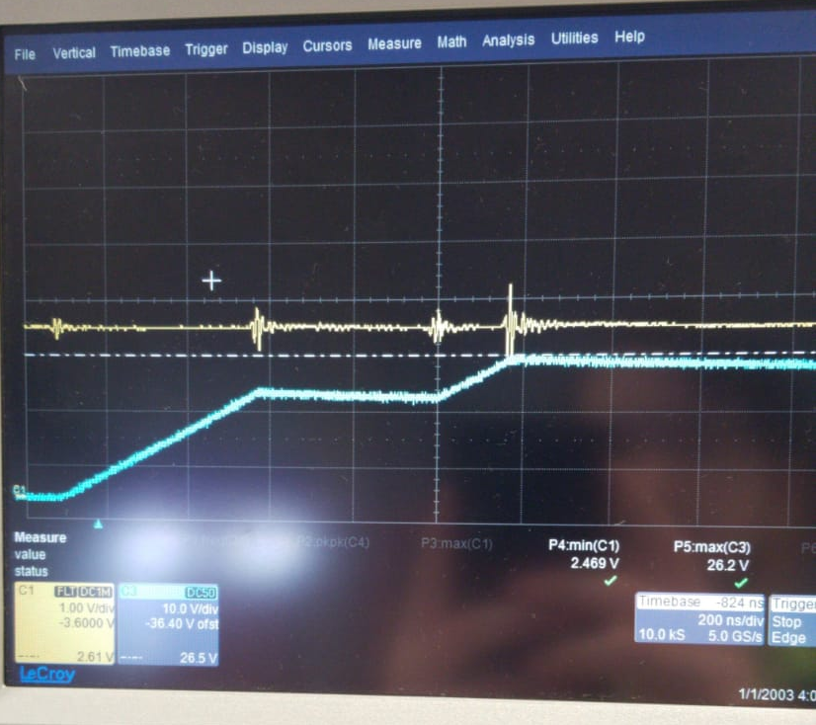
Noise
Whenever we touch to measure, it works. If we don’t touch, SC gets triggered.
Why does SC get triggered if 5V is not distorted? Lets measure Vref
@220V
Yellow Vref
Blue LoadCurrent

Slide 4
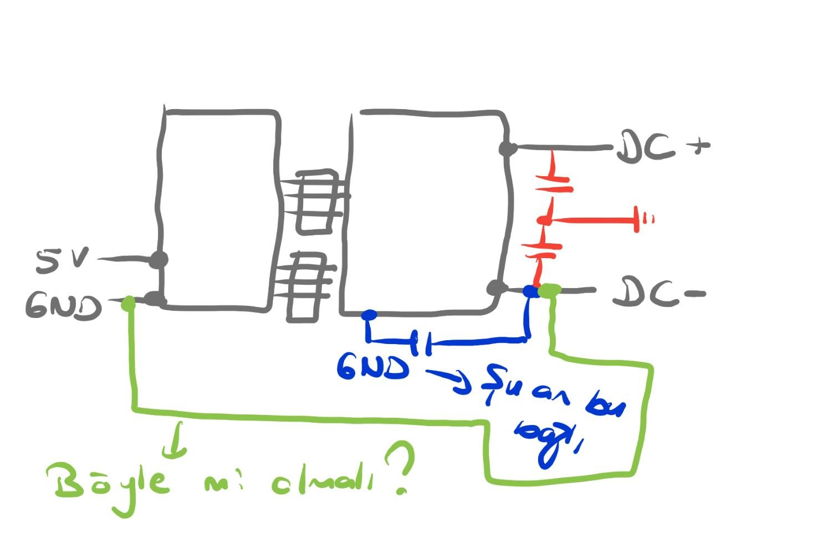
Noise
I think we connected Ciso wrong. We should connect it between terminals.

Slide 5
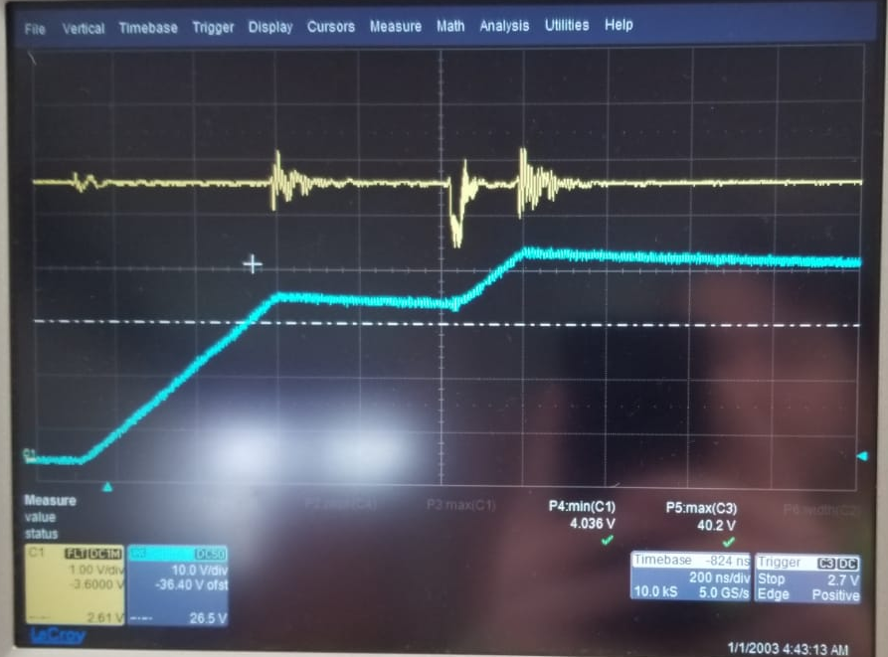
Noise
5V drops again, capacitor did not change anything ☹
Lets change the capacitor connection and try
@350V
Yellow 5V
Blue LoadCurrent

Slide 6
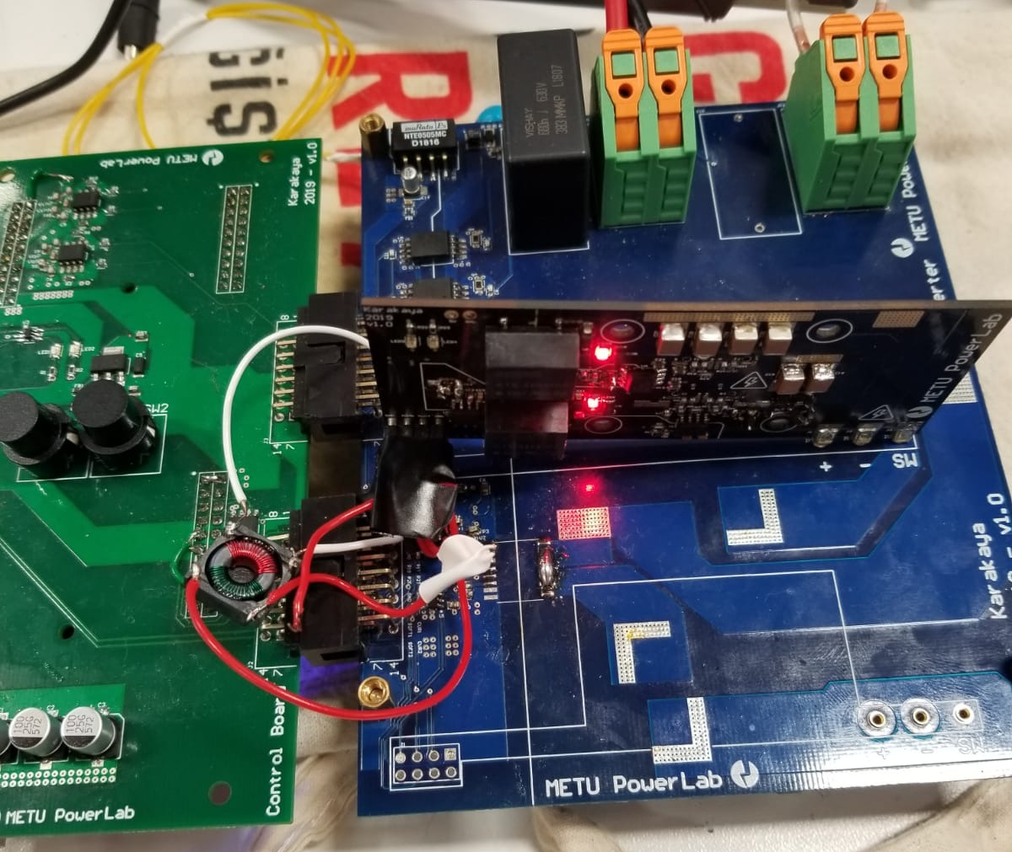
Noise
Why don’t we use the common mode filter. Lets put in series with 5V supply of half-bridge board.
With this configuration it we started to observe problem at 250V. Might it be because we have a longer path?

Slide 7
Noise
Lets put some capacitor on half-bridge board for 5V bus and see if it helps
We managed to increase voltage up to 350V again with extra 100uF, 3x10uF . 5V drops again down to 4V. Then

Slide 8
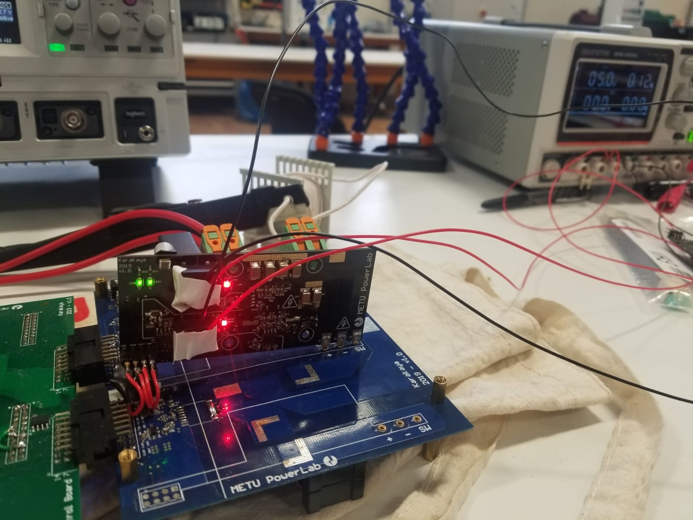
Noise
If it is a differential noise then why don’t we supply isolated converters with anouther source?

Slide 9
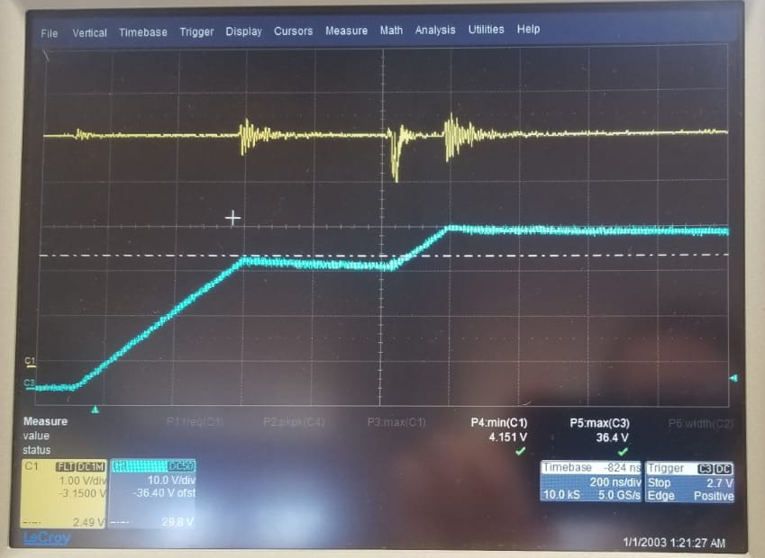
Noise
5V still drops
If it is a differential noise then why don’t we supply isolated converters with anouther source?
@350V
Yellow 5V
Blue LoadCurrent

Slide 10
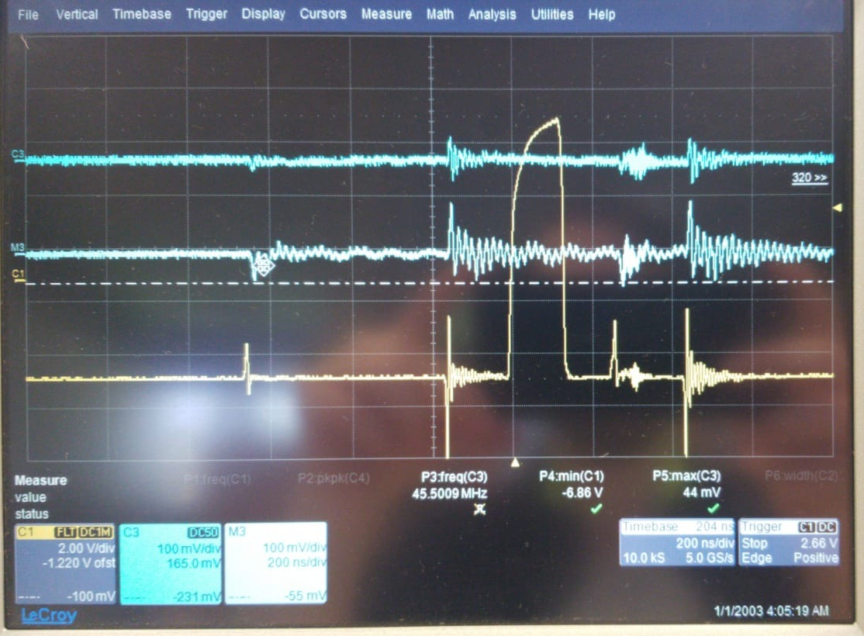
Noise
It seems filter helps, but the problem continues
Lets measure the common mode current for driver converters supply
@350V
Yellow Vgsbot
Top Blue with filter
Bot Blue without filter

Slide 11
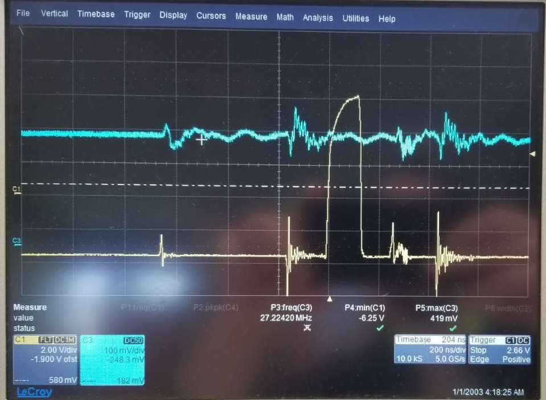
Noise
Differential current
Lets measure the current of 5V which supplies components other than GD converter
@350V
Yellow Vgsbot
Blue Diff Curr

Slide 12
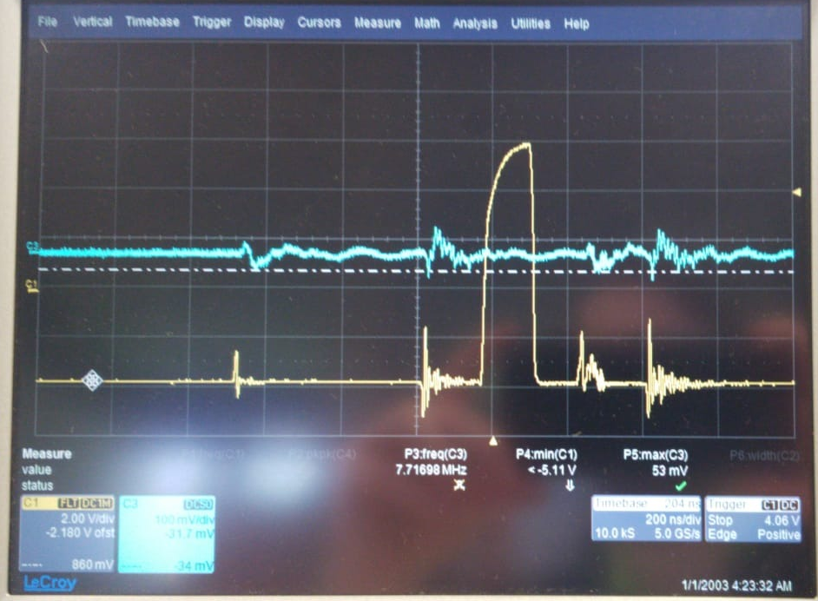
Noise
Why is it that similar to differential current
Lets measure the current of 5V which supplies components other than GD converter
@350V
Yellow Vgsbot
Blue CM Curr

Slide 13
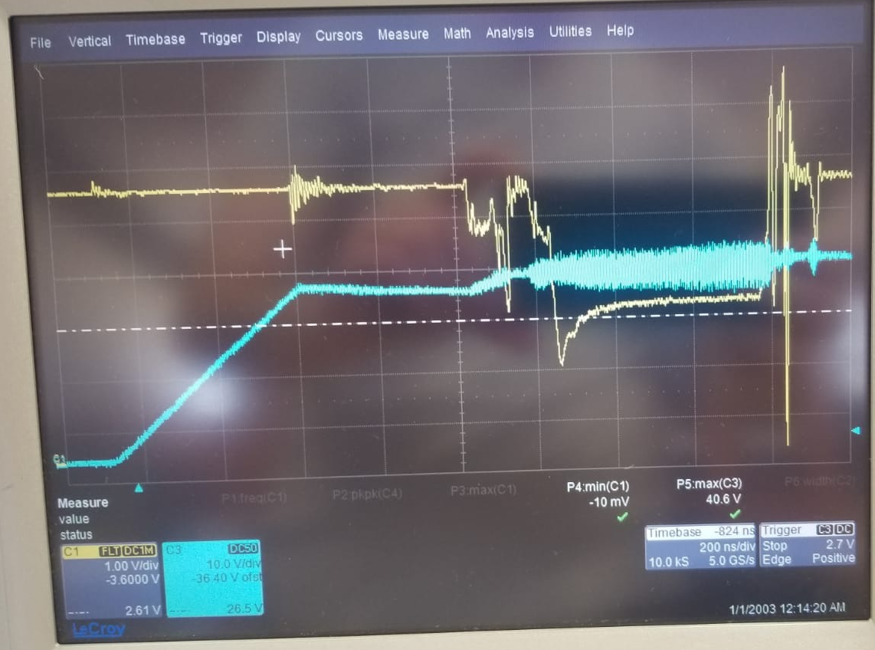
Noise
It gets completely distorted
Lets see what happens at 400V
@400V
Yellow 5V
Blue Load Curr

Slide 14
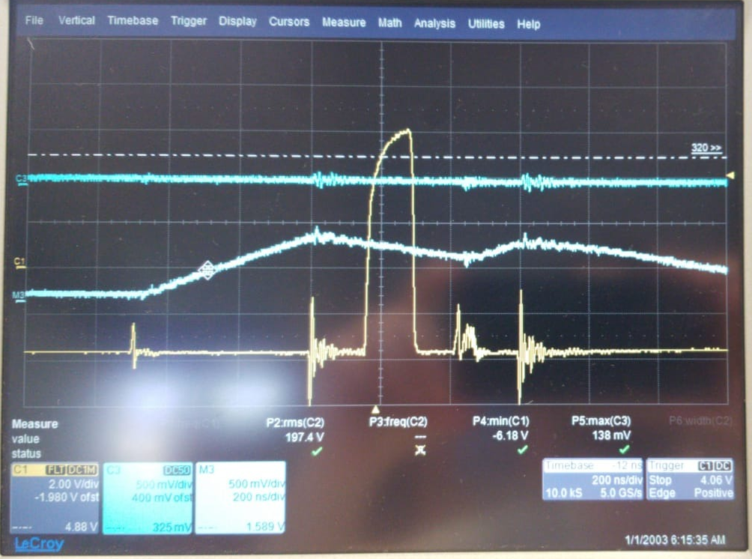
Noise
Differential current while, common mod filter is connected only to high side supply
What about the current of GD converter supply?
@350V
Yellow Vgsbot
Top Blue High Side Supply
Bot Blue Low Side Supply

Slide 15
Noise

Slide 16
Noise
Why is 5V still affected by switching where it does not supply anything regardin switching?

